Slide 1
MyCFR
COLLEGE FOOTBALL’S VERY OWN RECRUITING DASHBOARD
STREAMLINE YOUR RECRUITING STRATEGY
WITH
FIRST IN. ALWAYS WINS.

Slide 2
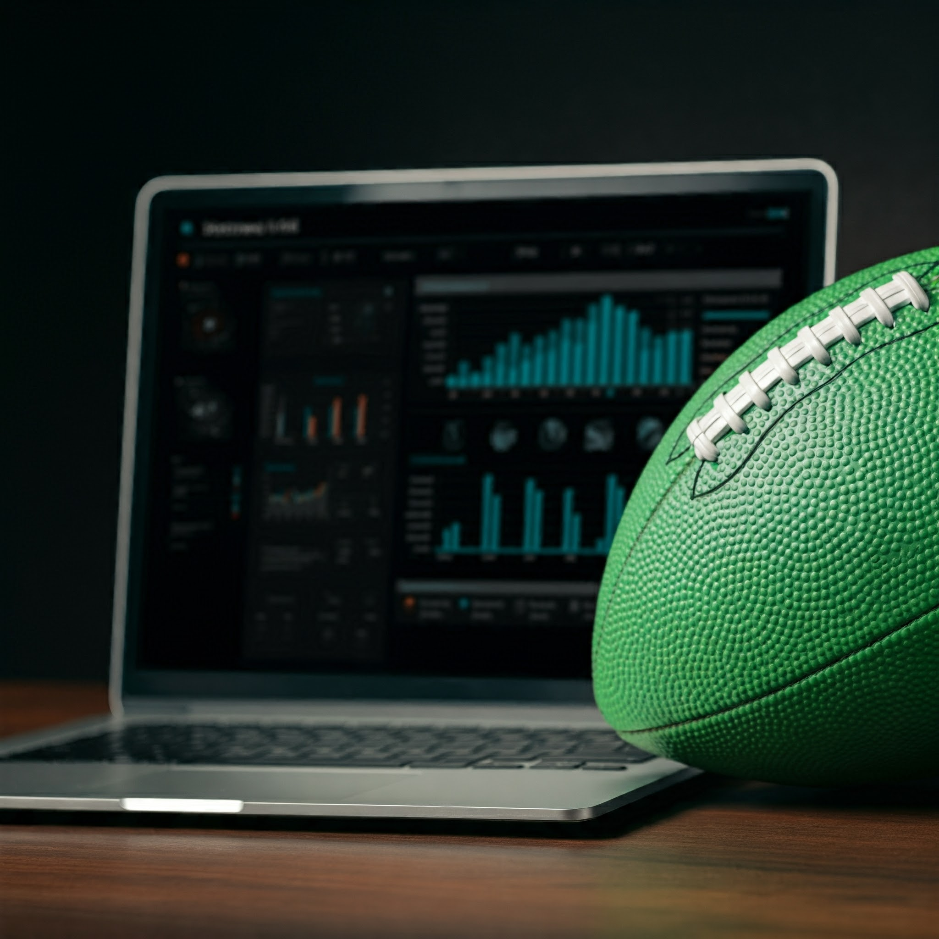
MyCFR Software Benefits
Increased Efficiency
Improved Decision Making
Enhanced Communication
Competitive Advantage

Slide 3
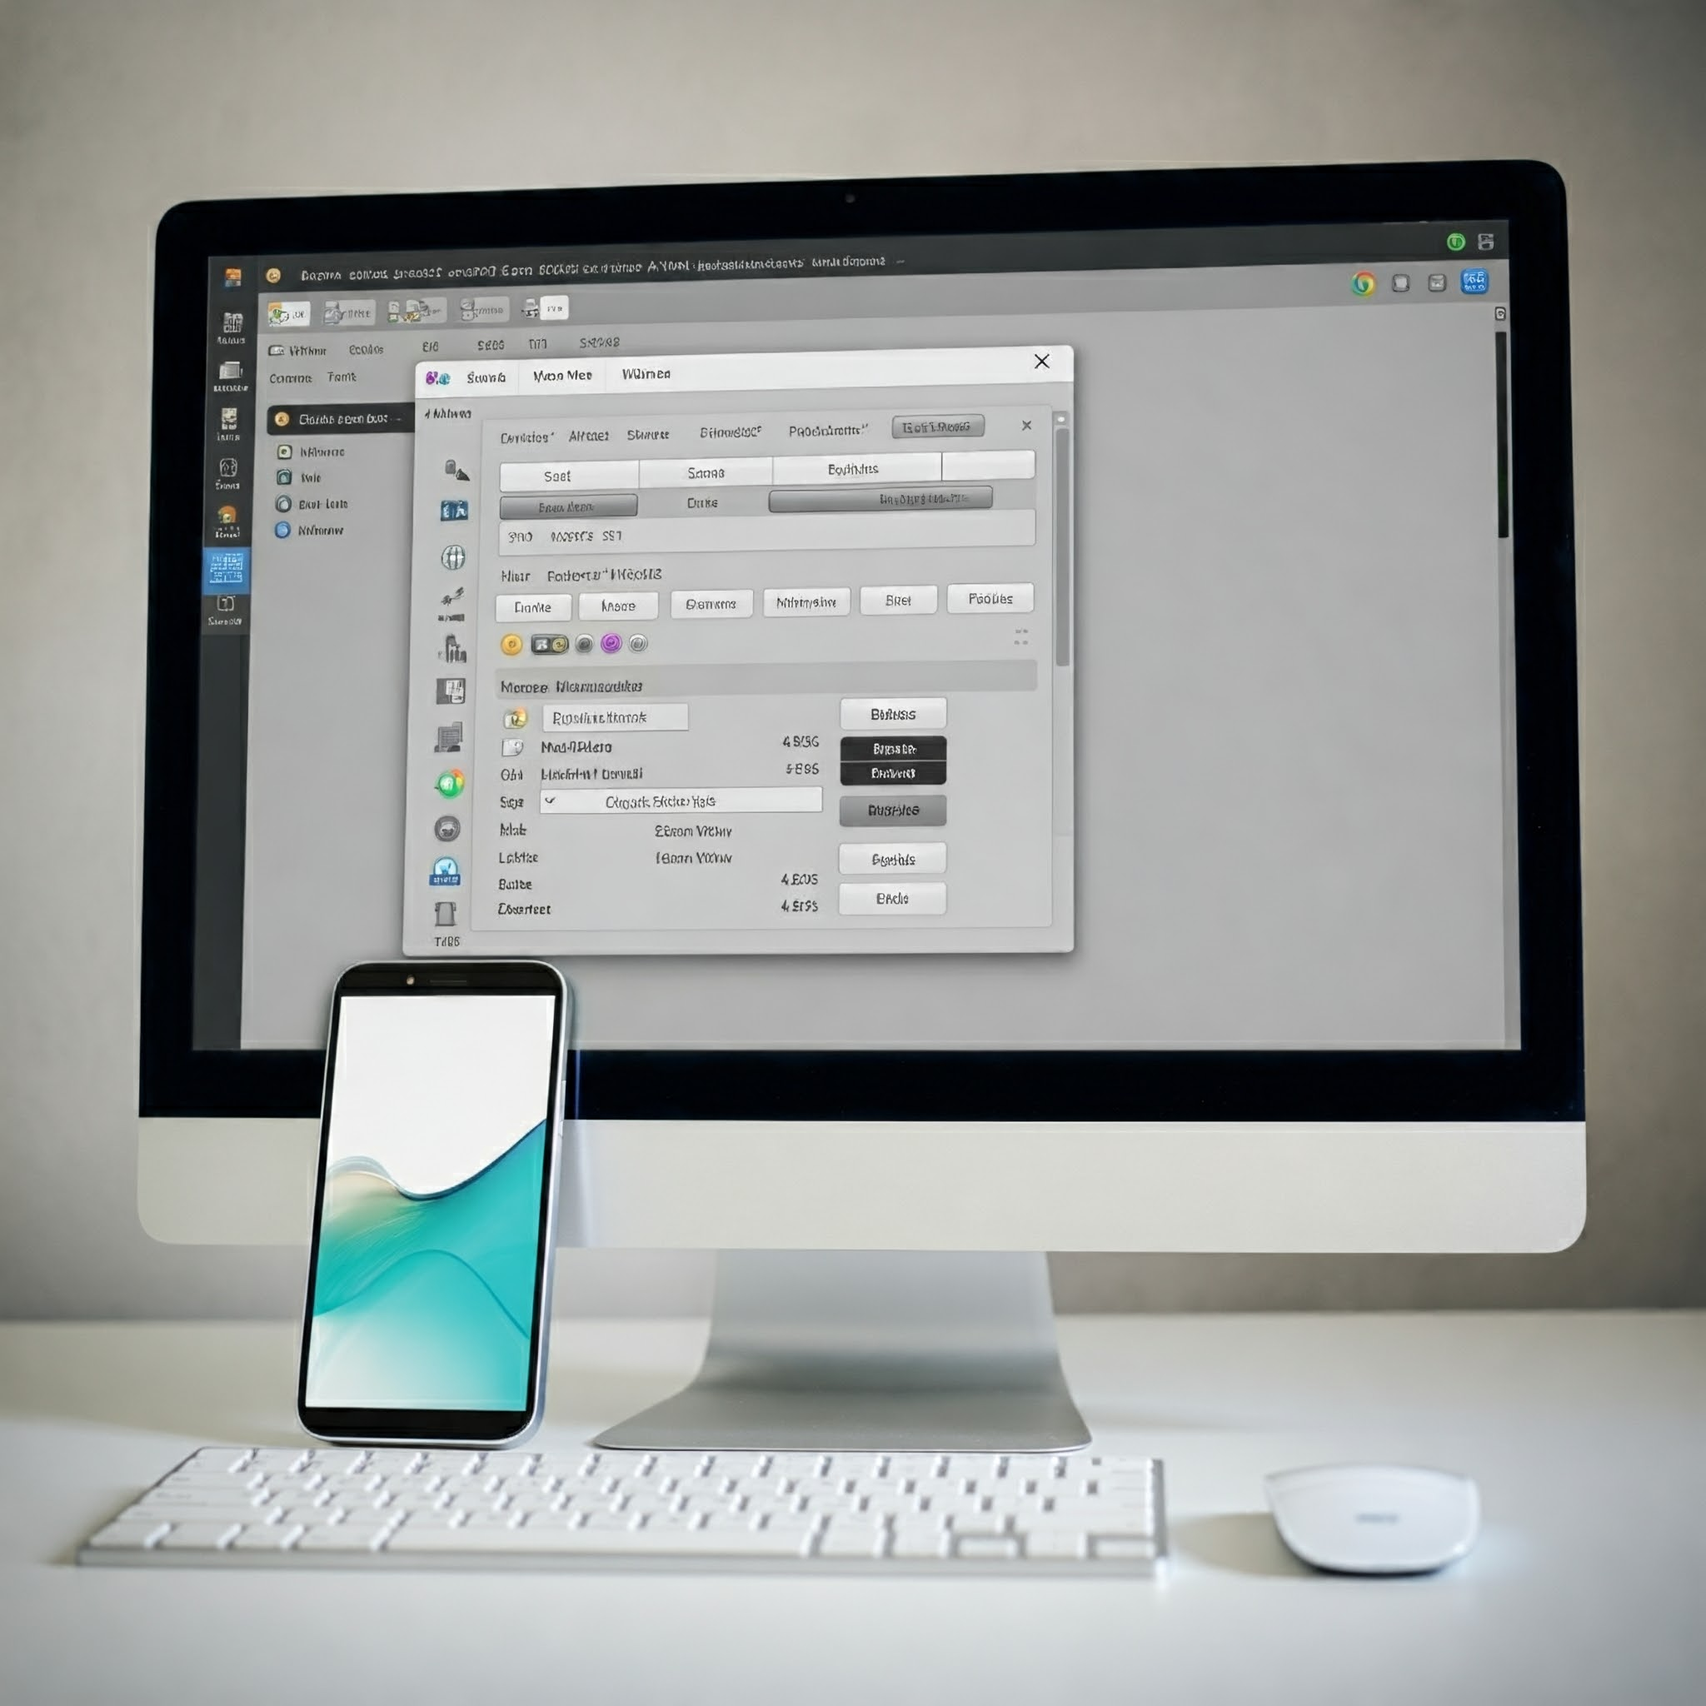
MyCFR's Key Goals & Characteristics
Centralized Database: All recruiting data in one place.
Automated Offer Tracking: Monitor recruits in real time.
Advanced Analytics: Identify trends and make informed decisions.
Integration: Works with existing systems (NCAA, ARMS).
Mobile Access: Recruit info on the go.
Customization: Tailored views of key metrics.

Slide 4


The Recruiting Game is Changing. Are You Keeping Up?
Coaches are drowning in data from disparate sources.
Inefficient workflows waste valuable time and resources.
Data from recruiting services lack specificity to your organization.
Manual data entry is tedious and error-prone which leads to operational bottlenecks that compound over time. I’ve been there!

Slide 5

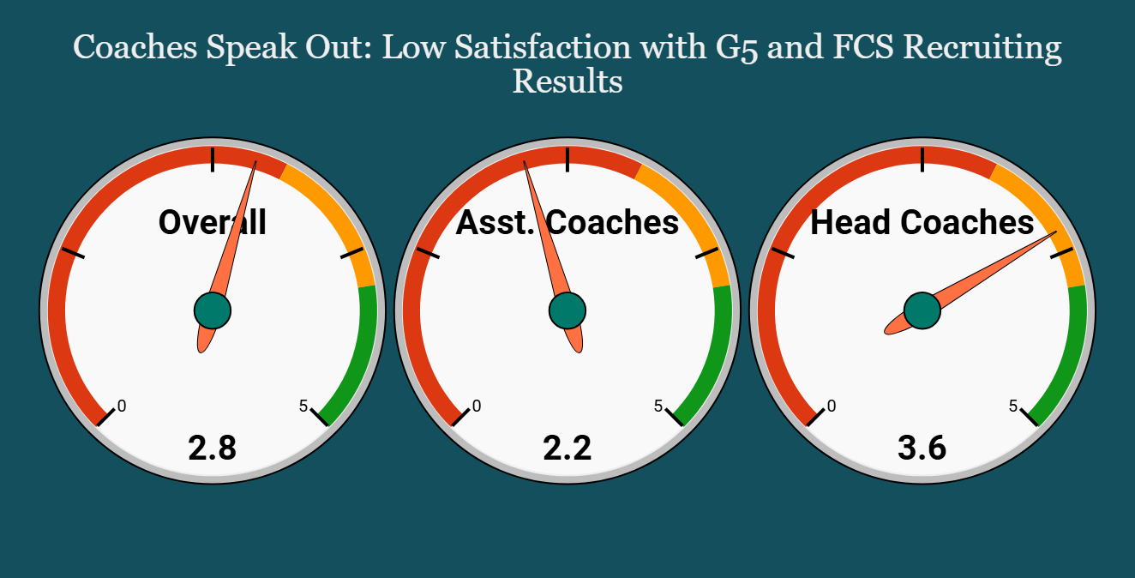
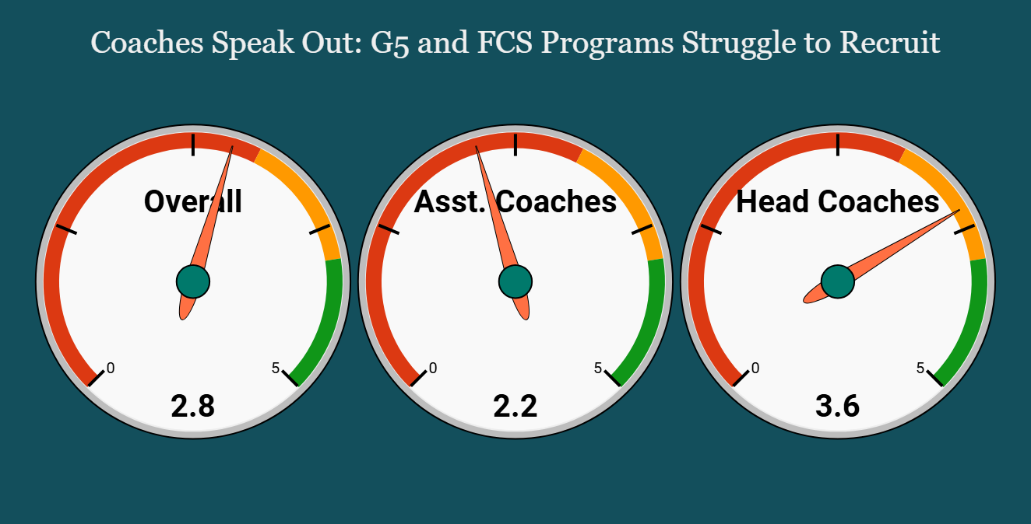
We've Surveyed the Coaches
83% of coaches rely on inefficient spreadsheets.
67% struggle to track recruits across platforms.
50% waste time on manual data entry.
42% lack insights for data-driven decisions.

Slide 6
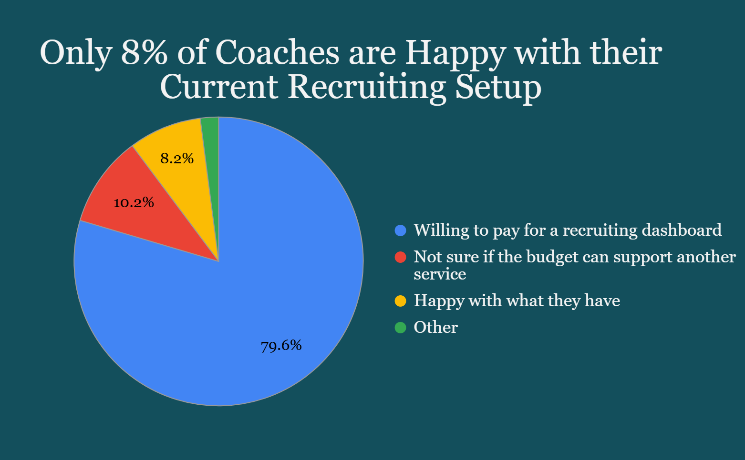
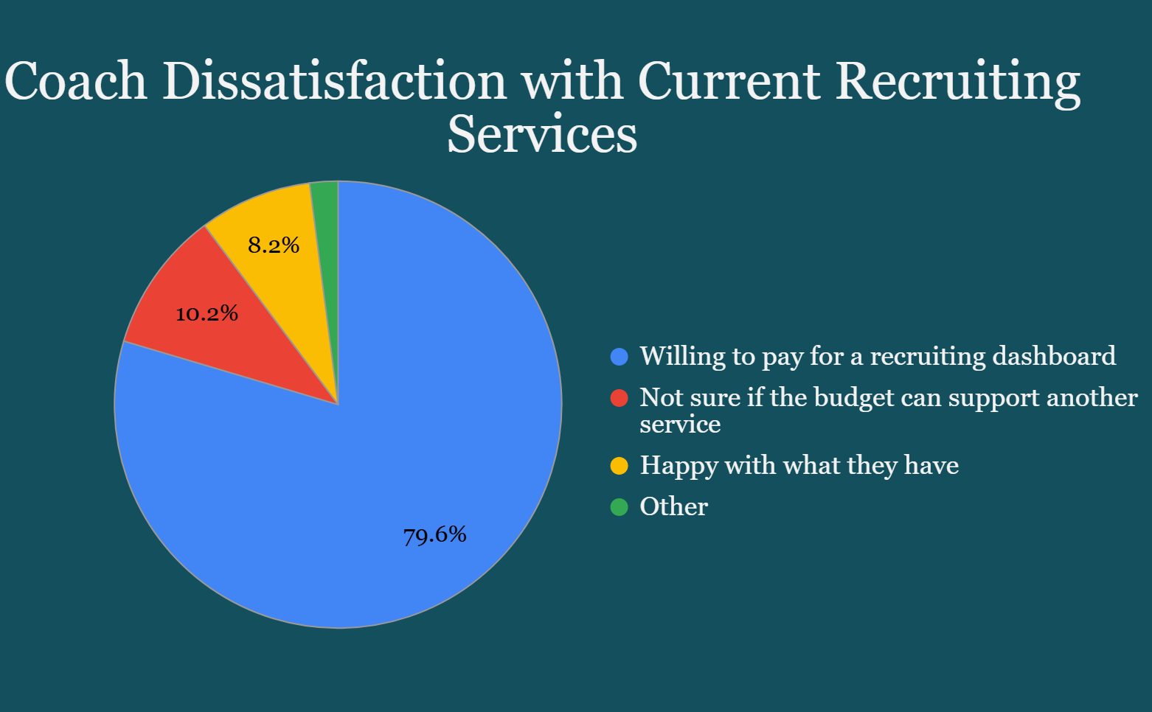

Coach Dissatisfaction with Current Recruiting Services
Manual data entry is time-consuming and inefficient.
Lack of integration between recruiting platforms.
Difficulty tracking prospect academic eligibility.
Limited insights for data-driven decision-making.
Recruiting services are expensive.

Slide 7

Our Solution: The MyCFR Dashboard Advantage
Centralized Recruiting Hub: Streamline your process, saving time and resources.
Data-Driven Decisions: Real-time data and analytics for informed decisions.
Enhanced Communication: Centralized communication hub for coaches.
Compliance and Competitive Edge: Stay compliant and gain a recruiting advantage.

Slide 8

Key Features: Dominate the Game
Player Ranking Module: Analyze athletic fit and recruitability of prospects specific to your program. Optimal Recruiting Rank.
Academic progress tracker: Monitor eligibility, gather transcript with weekly questionnaires and judge academic risk on the fly.
Communication Recommendation: Streamline communication with recruits and staff by predicting when the best time to call a recruit is. Then use the communication logs to track recruiting activity across coaches in your program.
Advanced analytics and reporting: Identify trends in roster management and measure the ROI of your team’s recruiting efforts. Want to explore an area you’ve never recruited? Te nada.

Slide 9
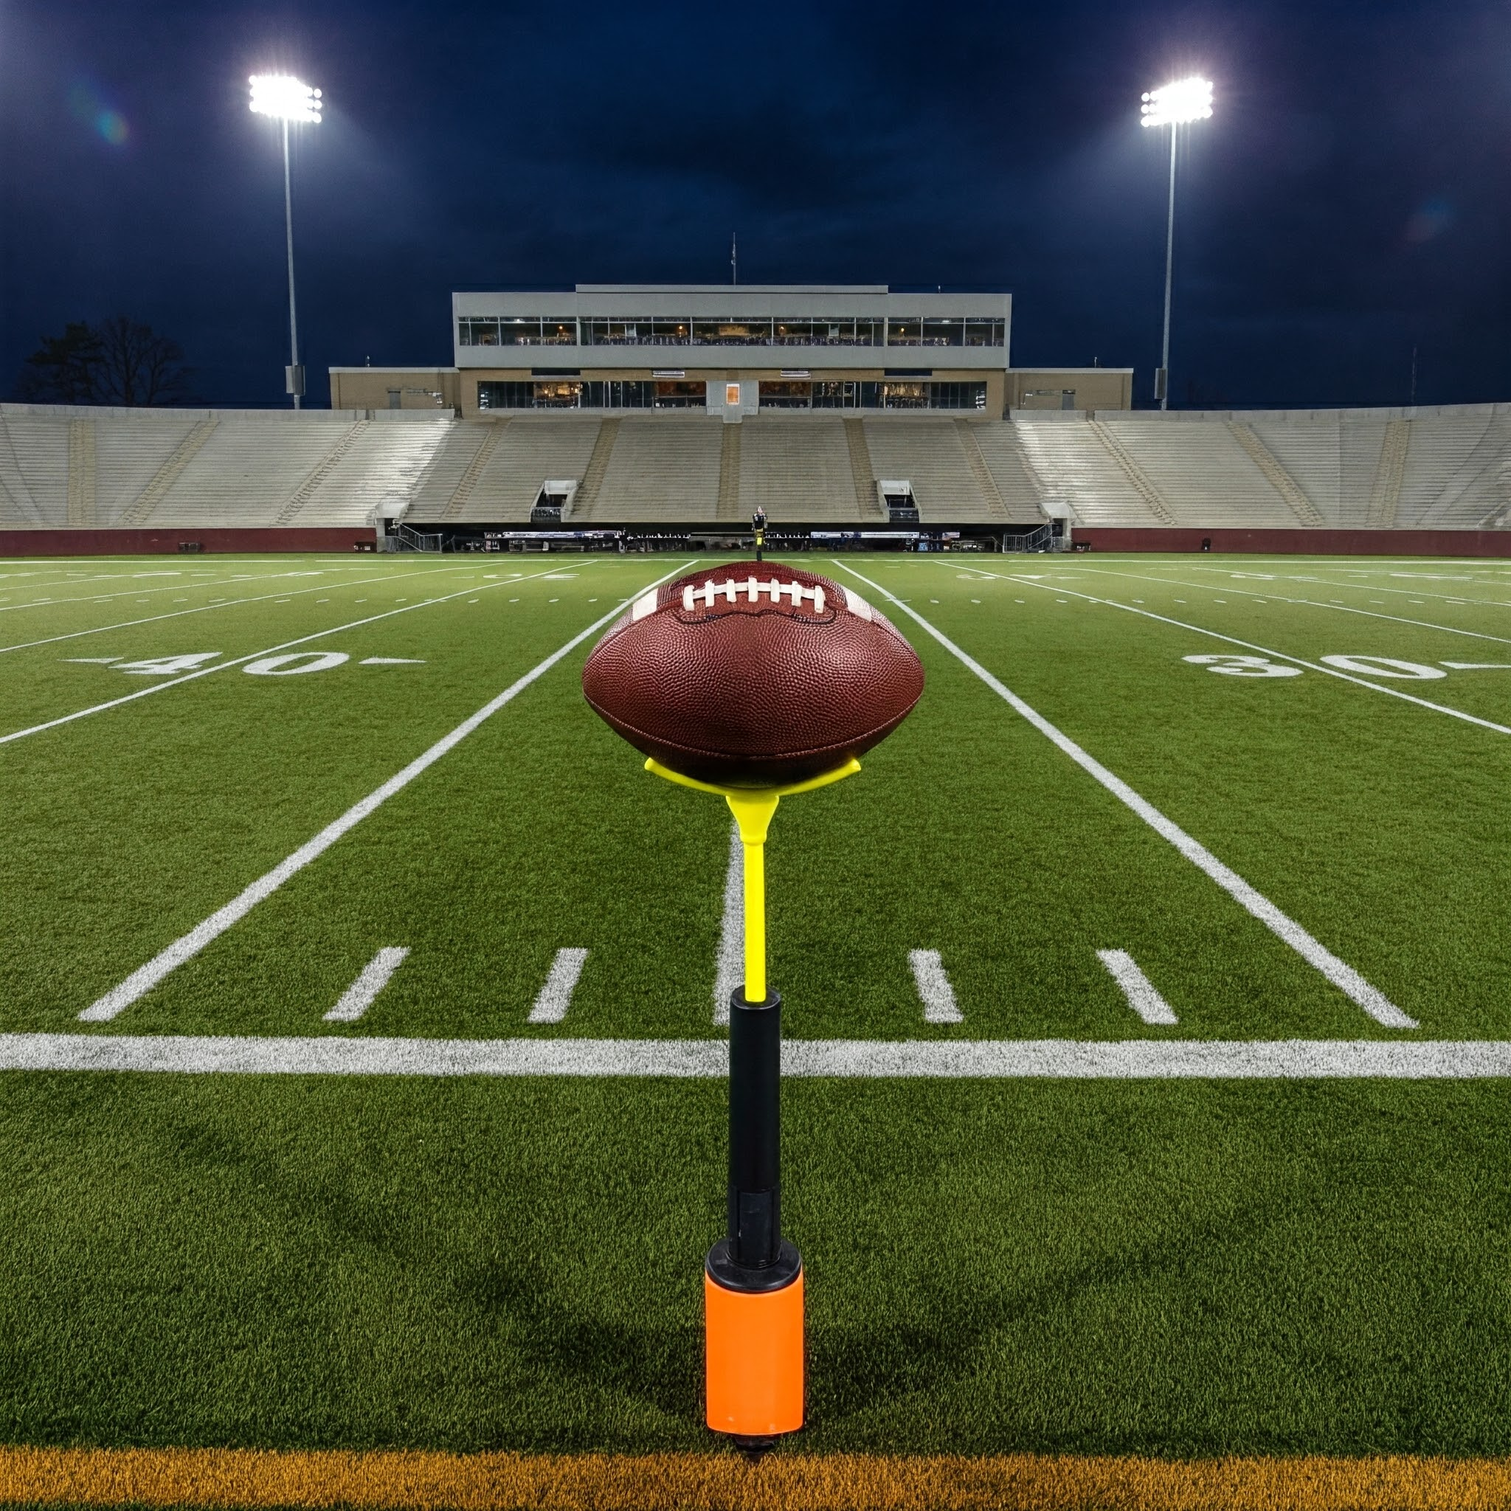
MyCFR: Advanced Analytics
Recruiting Viability" score for every prospect.
Factors: Military family, parents' location, physical attributes, academics, etc.
High School Tier Ranking.
Insights on state athletic demographics.
Area recruiting analysis.

Slide 10
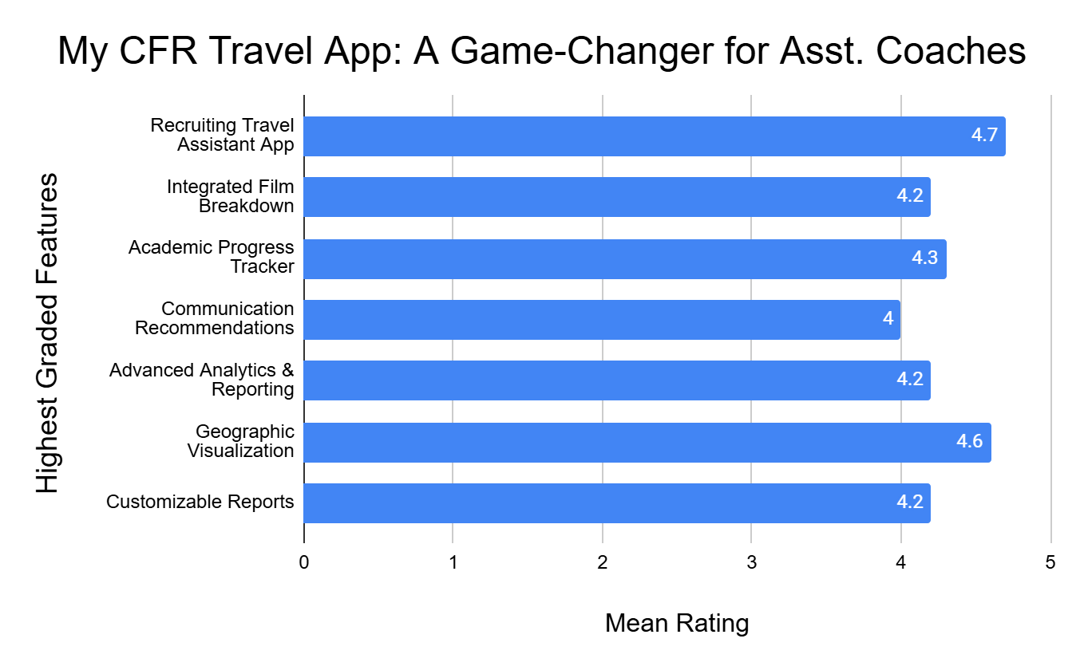
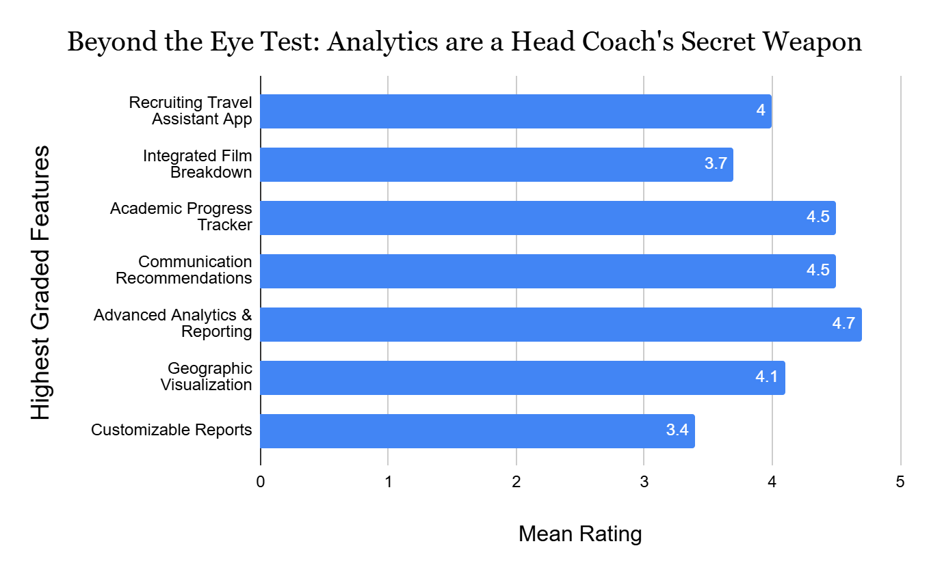
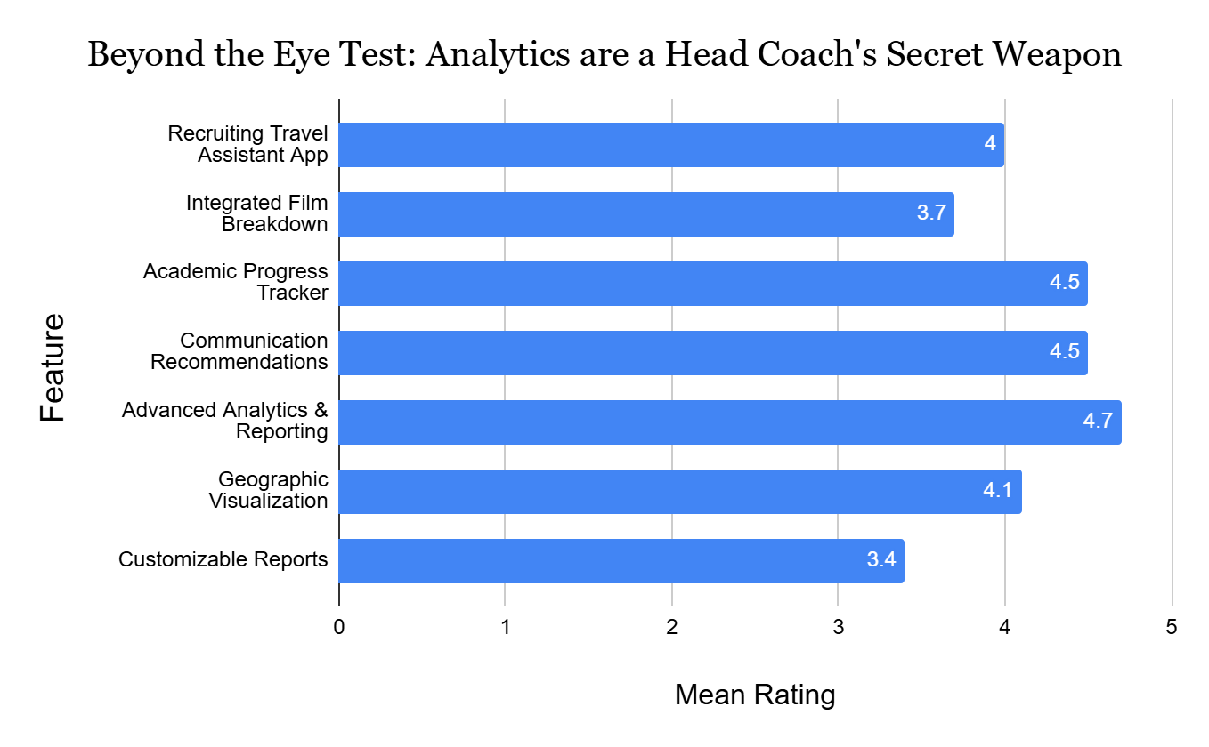
Asst. Coach Feedback
HC Feedback
83% of coaches use inefficient spreadsheets.
67% struggle to track recruits across platforms.
50% waste time on manual data entry.
42% lack insights for data-driven decisions.

Slide 11

MyCFR Data Integration: This one’s for the Recruiting Coaches
MyCFR integrates data from all your sources.
Get a 360-degree view of prospects.
Scouting services, ARMS database, information your coaches have gathered.
All your data in one place.
Allows for deeper insights before you offer.

Slide 12

MyCFR: Built for Growth, Secured for Peace of Mind
Scalable architecture: Handles increasing data volume as your program expands.
Data security: Protects sensitive recruit and program information.
Privacy compliance: Adheres to NCAA and data privacy regulations.
Robust infrastructure: Ensures system reliability and uptime.
Future-ready: Designed to adapt to evolving technology and recruiting landscape.

Slide 13


User-Friendly Interface
Intuitive Interface: Easy to navigate and use.
User-Friendly Design: Minimal learning curve.
Streamlined Workflow: Focus on recruiting, not data entry.
Efficient Data Management: Quick access to the information you need.
Mobile Accessibility: Manage recruiting on the go.

Slide 14


MyCFR Summarized: Your Competitive Advantage
Identify and prioritize best-fit recruits
Optimize travel schedules and resource allocation with products to be released down the road.
Make data-driven decisions with confidence using historical data and integrating different sources.
Build a winning program, on and off the field. Roster management is a 24/7 365 day endeavour. Your competitor’s are streamlining it.

Slide 15
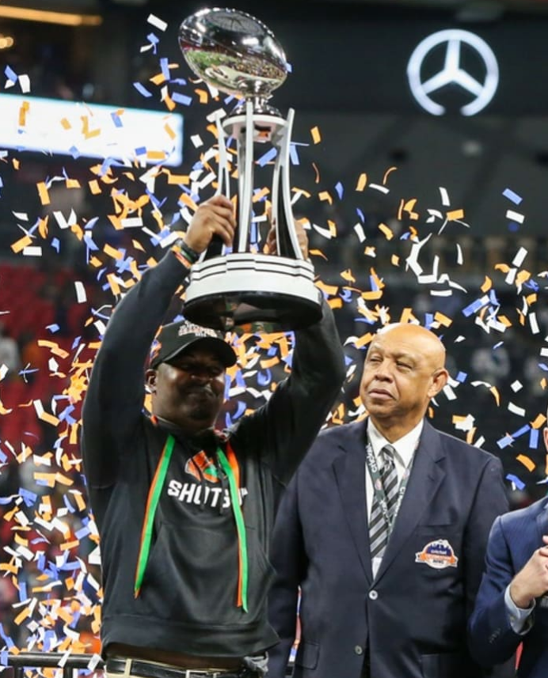
Revolutionize Your Recruiting
Contact us for a free demo and consultation.
See how MyCFR can transform your recruiting process.
Website: soon to be deployed
Email: delroy.nichols@gmail.com

Slide 16

Where do we go from here?
Two year Pilot Program with Stony Brook Football to iron out the kinks.
How does MyCFR integrate with our existing recruiting databases?
Can we customize the dashboard to track specific metrics?
How does the pricing structure work?
What kind of training and support do you offer?

Slide 17


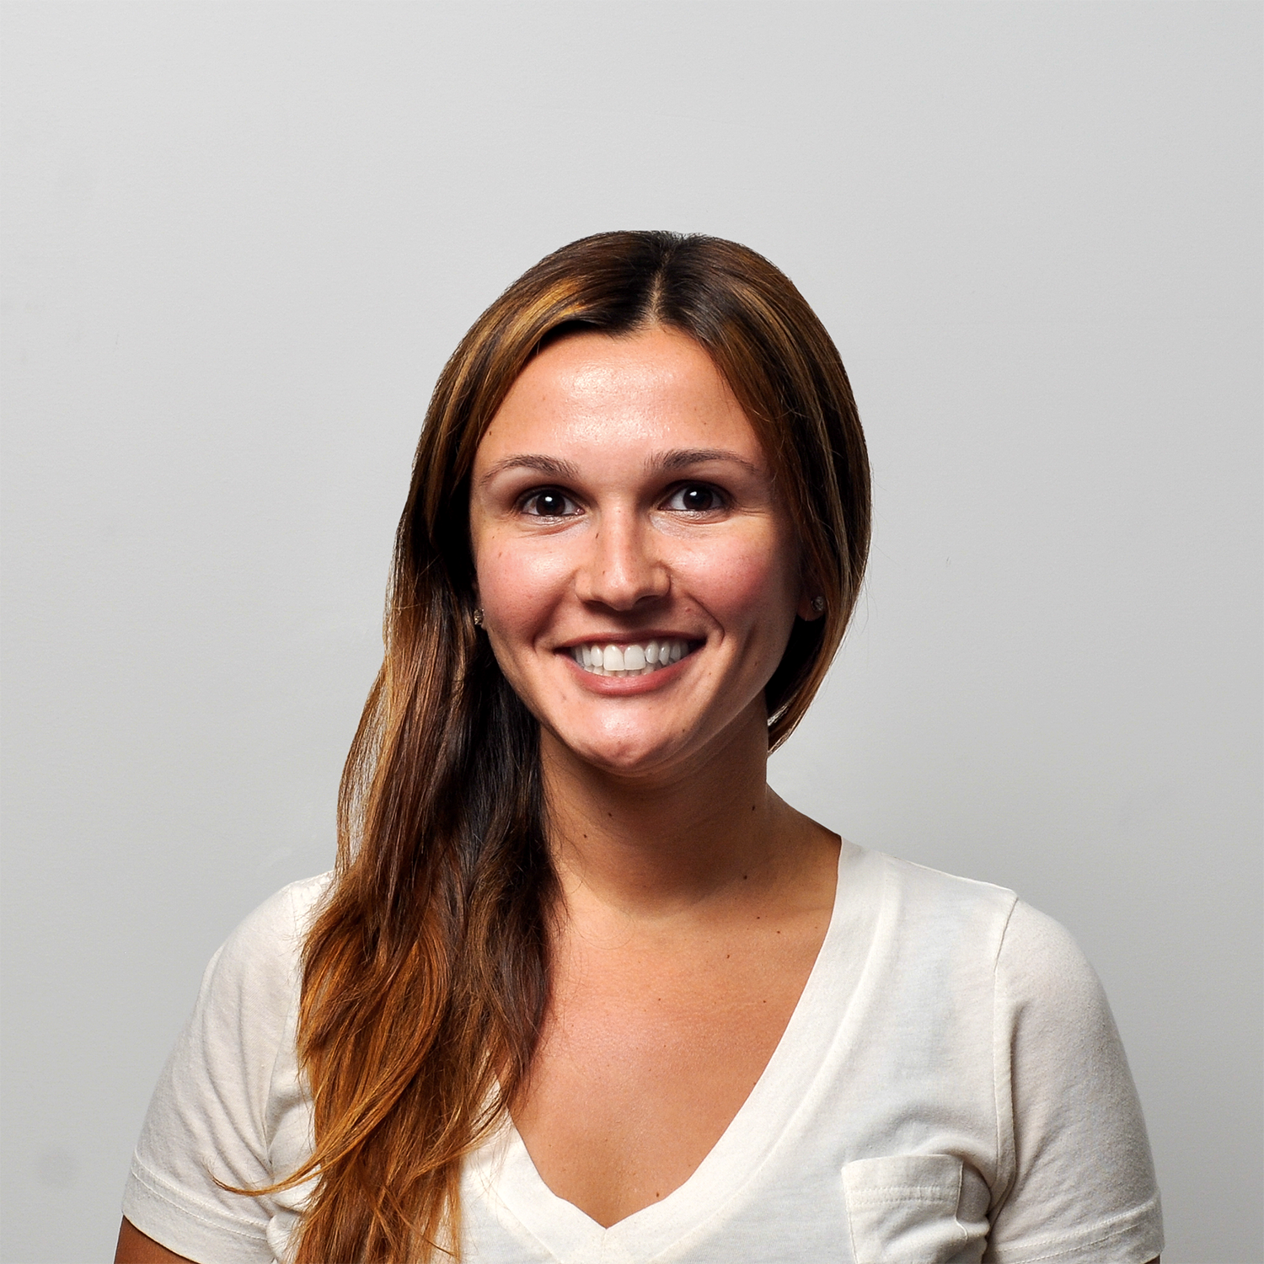

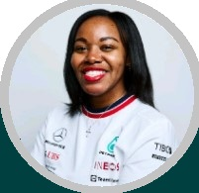
The Team
Chantell Nichols, Co-Founder, CTO
Jonathan Micklos, V.P. of Operations
Connor Waltz, Lead Visual Designer
Kayla Harris, CSO
Senior Software Engineer @ Verica (Tech Startup)
Multiple Years of Tech Startup Experience
Former Video Scout @ Sports Info Solutions
MLB Operations Assistant
Senior Game Designer @ Playstation
Former Director of Design for CFB 25 and MLB The Show
Assistant Director of Creative Design @ Mississippi State
Former Creative Associate at USMA West Point

